Slide 1
Logistic Regression

Slide 2

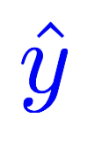
Linear model
Linear
Hours (x) | Points
1 | 2
2 | 4
3 | 6
4 | ?
Notes:
\hat{y}=x*w+b

Slide 3
Binary prediction (0 or 1) is very useful!
Spent N hours for study, pass or fail?
GPA and GRE scores for the PHD program, admit or not?
Soccer game against Japan, win or lose?
She/he looks good, propose or not?
…

Slide 4
Linear to binary (pass/fail, 0/1)
Linear
Hours (x) | Points
1 | 2
2 | 4
3 | 6
4 | ?
fail/pass
0
0
1
?
Notes:
\hat{y}=x*w+b

Slide 5
Logistic regression: pass/fail (0 or 1)
Linear
Linear
Sigmoid
Hours (x) | Points
1 | 2
2 | 4
3 | 6
4 | ?
fail/pass
0
0
1
?
Notes:
\hat{y}=x*w+b

Slide 6
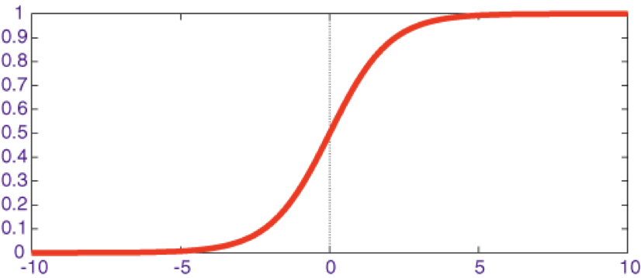
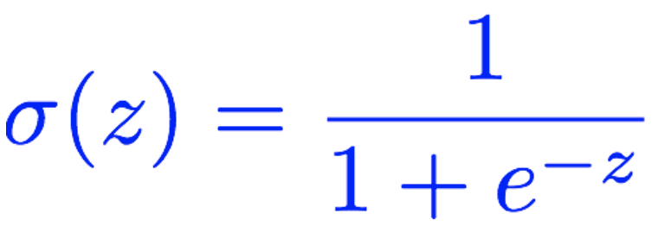
Meet Sigmoid
Linear
Linear
Sigmoid
Hours (x) | Points
1 | 2
2 | 4
3 | 6
4 | ?
fail/pass
0
0
1
?
Notes:
\hat{y}=x*w+b

Slide 7
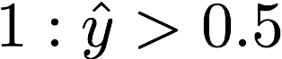
Meet Sigmoid
Linear
Linear
Sigmoid
Hours (x) | Points
1 | 2
2 | 4
3 | 6
4 | ?
fail/pass
0
0
1
?
Notes:
\hat{y}=x*w+b

Slide 8
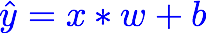
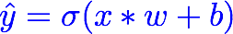
Meet sigmoid
Linear
Linear
Sigmoid
Hours (x) | Points
1 | 2
2 | 4
3 | 6
4 | ?
fail/pass
0
0
1
?
Notes:
\hat{y}=x*w+b
loss = \frac{1}{N}\sum_{n=1}^{N} y^{(n)} \log \hat{y}^{(n)} + (1 - y^{(n)}) \log (1-\hat{y}^{(n})

Slide 9
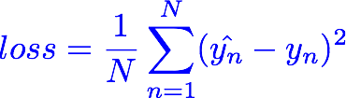
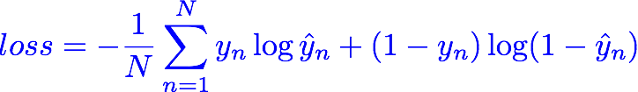
Meet Cross Entropy Loss
Linear
Linear
Sigmoid
Hours (x) | Points
1 | 2
2 | 4
3 | 6
4 | ?
fail/pass
0
0
1
?
Notes:
\hat{y}=x*w+b
loss = \frac{1}{N}\sum_{n=1}^{N} y^{(n)} \log \hat{y}^{(n)} + (1 - y^{(n)}) \log (1-\hat{y}^{(n})

Slide 10
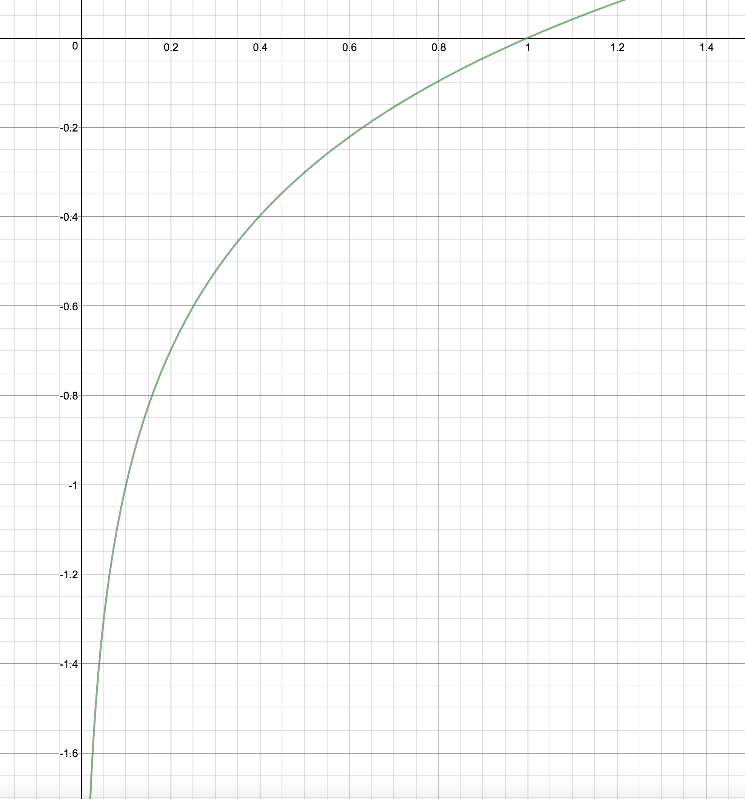
(Binary) Cross Entropy Loss
z
y | y_pred | loss
1 | 0.2
1 | 0.8
0 | 0.1
0 | 0.9
log(z)
Notes:
\hat{y}=x*w+b
loss = \frac{1}{N}\sum_{n=1}^{N} y^{(n)} \log \hat{y}^{(n)} + (1 - y^{(n)}) \log (1-\hat{y}^{(n})

Slide 11
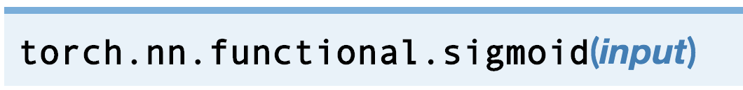
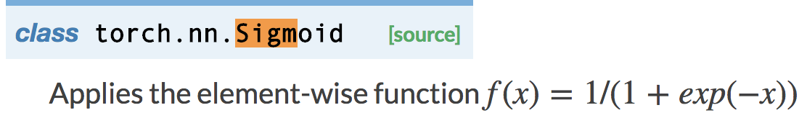
Logistic regression
Linear
Sigmoid
import torch.nn.functional as F
class Model(torch.nn.Module):
def __init__(self):
super(Model, self).__init__()
self.linear = torch.nn.Linear(1, 1)
def forward(self, x):
y_pred = F.sigmoid(self.linear(x))
return y_pred
Notes:
\hat{y}=x*w+b
loss = \frac{1}{N}\sum_{n=1}^{N} y^{(n)} \log \hat{y}^{(n)} + (1 - y^{(n)}) \log (1-\hat{y}^{(n})

Slide 12

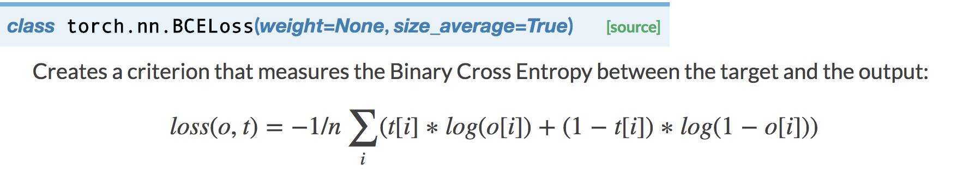
Logistic regression
Linear
Sigmoid
import torch.nn.functional as F
class Model(torch.nn.Module):
def __init__(self):
super(Model, self).__init__()
self.linear = torch.nn.Linear(1, 1)
def forward(self, x):
y_pred = F.sigmoid(self.linear(x))
return y_pred
criterion = torch.nn.BCELoss(size_average=True)
Notes:
\hat{y}=x*w+b
loss = \frac{1}{N}\sum_{n=1}^{N} y^{(n)} \log \hat{y}^{(n)} + (1 - y^{(n)}) \log (1-\hat{y}^{(n})

Slide 13
PHD Program Application
GPA (a) | Admission?
2.1 | 0
4.2 | 1
3.1 | 0
3.3 | 1
Linear
Sigmoid
x_data =[[2.1],
[4.2],
[3.1],
[3.3]]
y_data =[[0.0],
[1.0],
[0.0],
[1.0]]

Slide 14
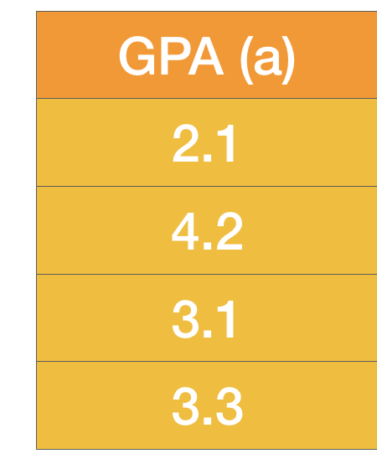
GPA enough?
How about experience and others?
Experience (b) | Admission?
0.1 | 0
0.8 | 1
0.9 | 0
0.2 | 1
Linear
Sigmoid
x_data =[[2.1, 0.1],
[4.2, 0.8],
[3.1, 0.9],
[3.3, 0.2]]
y_data =[[0.0],
[1.0],
[0.0],
[1.0]]

Slide 15
Matrix Multiplication
x_data =[[2.1, 0.1],
[4.2, 0.8],
[3.1, 0.9],
[3.3, 0.2]]
y_data =[[0.0],
[1.0],
[0.0],
[1.0]]
Linear
Sigmoid
Notes:
\begin{bmatrix}
a_{1} & b_{1} \\
a_{2} & b_{2} \\
a_{3} & b_{3} \\
\hdotsfor{2} \\
a_{n} & b_{n}
\end{bmatrix}
\begin{bmatrix}
w_1 \\ w_2 \\
\end{bmatrix}
=
\begin{bmatrix}
y_{1} \\
y_{2} \\
y_{3} \\
\hdotsfor{1} \\
y_{n}
\end{bmatrix}

Slide 16
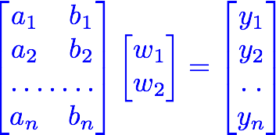
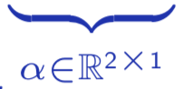
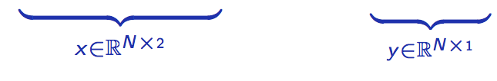
Matrix Multiplication
x_data =[[2.1, 0.1],
[4.2, 0.8],
[3.1, 0.9],
[3.3, 0.2]]
y_data =[[0.0],
[1.0],
[0.0],
[1.0]]
Linear
Sigmoid
Notes:
\begin{bmatrix}
a_{1} & b_{1} \\
a_{2} & b_{2} \\
a_{3} & b_{3} \\
\hdotsfor{2} \\
a_{n} & b_{n}
\end{bmatrix}
\begin{bmatrix}
w_1 \\ w_2 \\
\end{bmatrix}
=
\begin{bmatrix}
y_{1} \\
y_{2} \\
y_{3} \\
\hdotsfor{1} \\
y_{n}
\end{bmatrix}

Slide 17
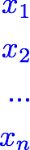
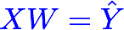
Matrix Multiplication
x_data =[[2.1, 0.1],
[4.2, 0.8],
[3.1, 0.9],
[3.3, 0.2]]
y_data =[[0.0],
[1.0],
[0.0],
[1.0]]
Linear
Sigmoid
Notes:
\begin{bmatrix}
a_{1} & b_{1} \\
a_{2} & b_{2} \\
a_{3} & b_{3} \\
\hdotsfor{2} \\
a_{n} & b_{n}
\end{bmatrix}
\begin{bmatrix}
w_1 \\ w_2 \\
\end{bmatrix}
=
\begin{bmatrix}
y_{1} \\
y_{2} \\
y_{3} \\
\hdotsfor{1} \\
y_{n}
\end{bmatrix}

Slide 18
Matrix Multiplication
x_data =[[2.1, 0.1],
[4.2, 0.8],
[3.1, 0.9],
[3.3, 0.2]]
y_data =[[0.0],
[1.0],
[0.0],
[1.0]]
Linear
Sigmoid
linear = torch.nn.Linear(2, 1)
y_prd = linear(x_data)
Notes:
\begin{bmatrix}
a_{1} & b_{1} \\
a_{2} & b_{2} \\
a_{3} & b_{3} \\
\hdotsfor{2} \\
a_{n} & b_{n}
\end{bmatrix}
\begin{bmatrix}
w_1 \\ w_2 \\
\end{bmatrix}
=
\begin{bmatrix}
y_{1} \\
y_{2} \\
y_{3} \\
\hdotsfor{1} \\
y_{n}
\end{bmatrix}

Slide 19
Go Wide!
Linear
Sigmoid
…
Linear
Sigmoid

Slide 20
Go Deep!
Linear
Sigmoid

Slide 21
Go Deep!
Linear
Sigmoid
Linear
Sigmoid
Linear
Sigmoid
…
sigmoid = torch.nn.Sigmoid()
l1 = torch.nn.Linear(2, 4)
l2 = torch.nn.Linear(4, 3)
l3 = torch.nn.Linear(3, 1)
out1 = sigmoid(l1(x_data))
out2 = sigmoid(l2(out1))
y_pred = sigmoid(l3(out2)

Slide 22
Sigmoid Activation Functions
Linear
Sigmoid

Slide 23
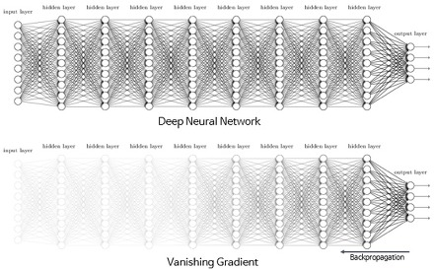
Sigmoid: Vanishing Gradient Problem
Linear
Sigmoid
http://excelsior-cjh.tistory.com/entry/RNN-LSTMLong-Short-Term-Memory-networks

Slide 24

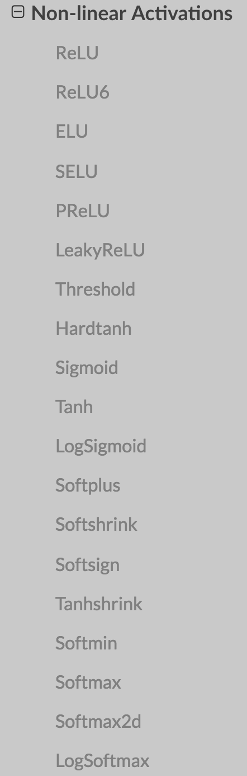
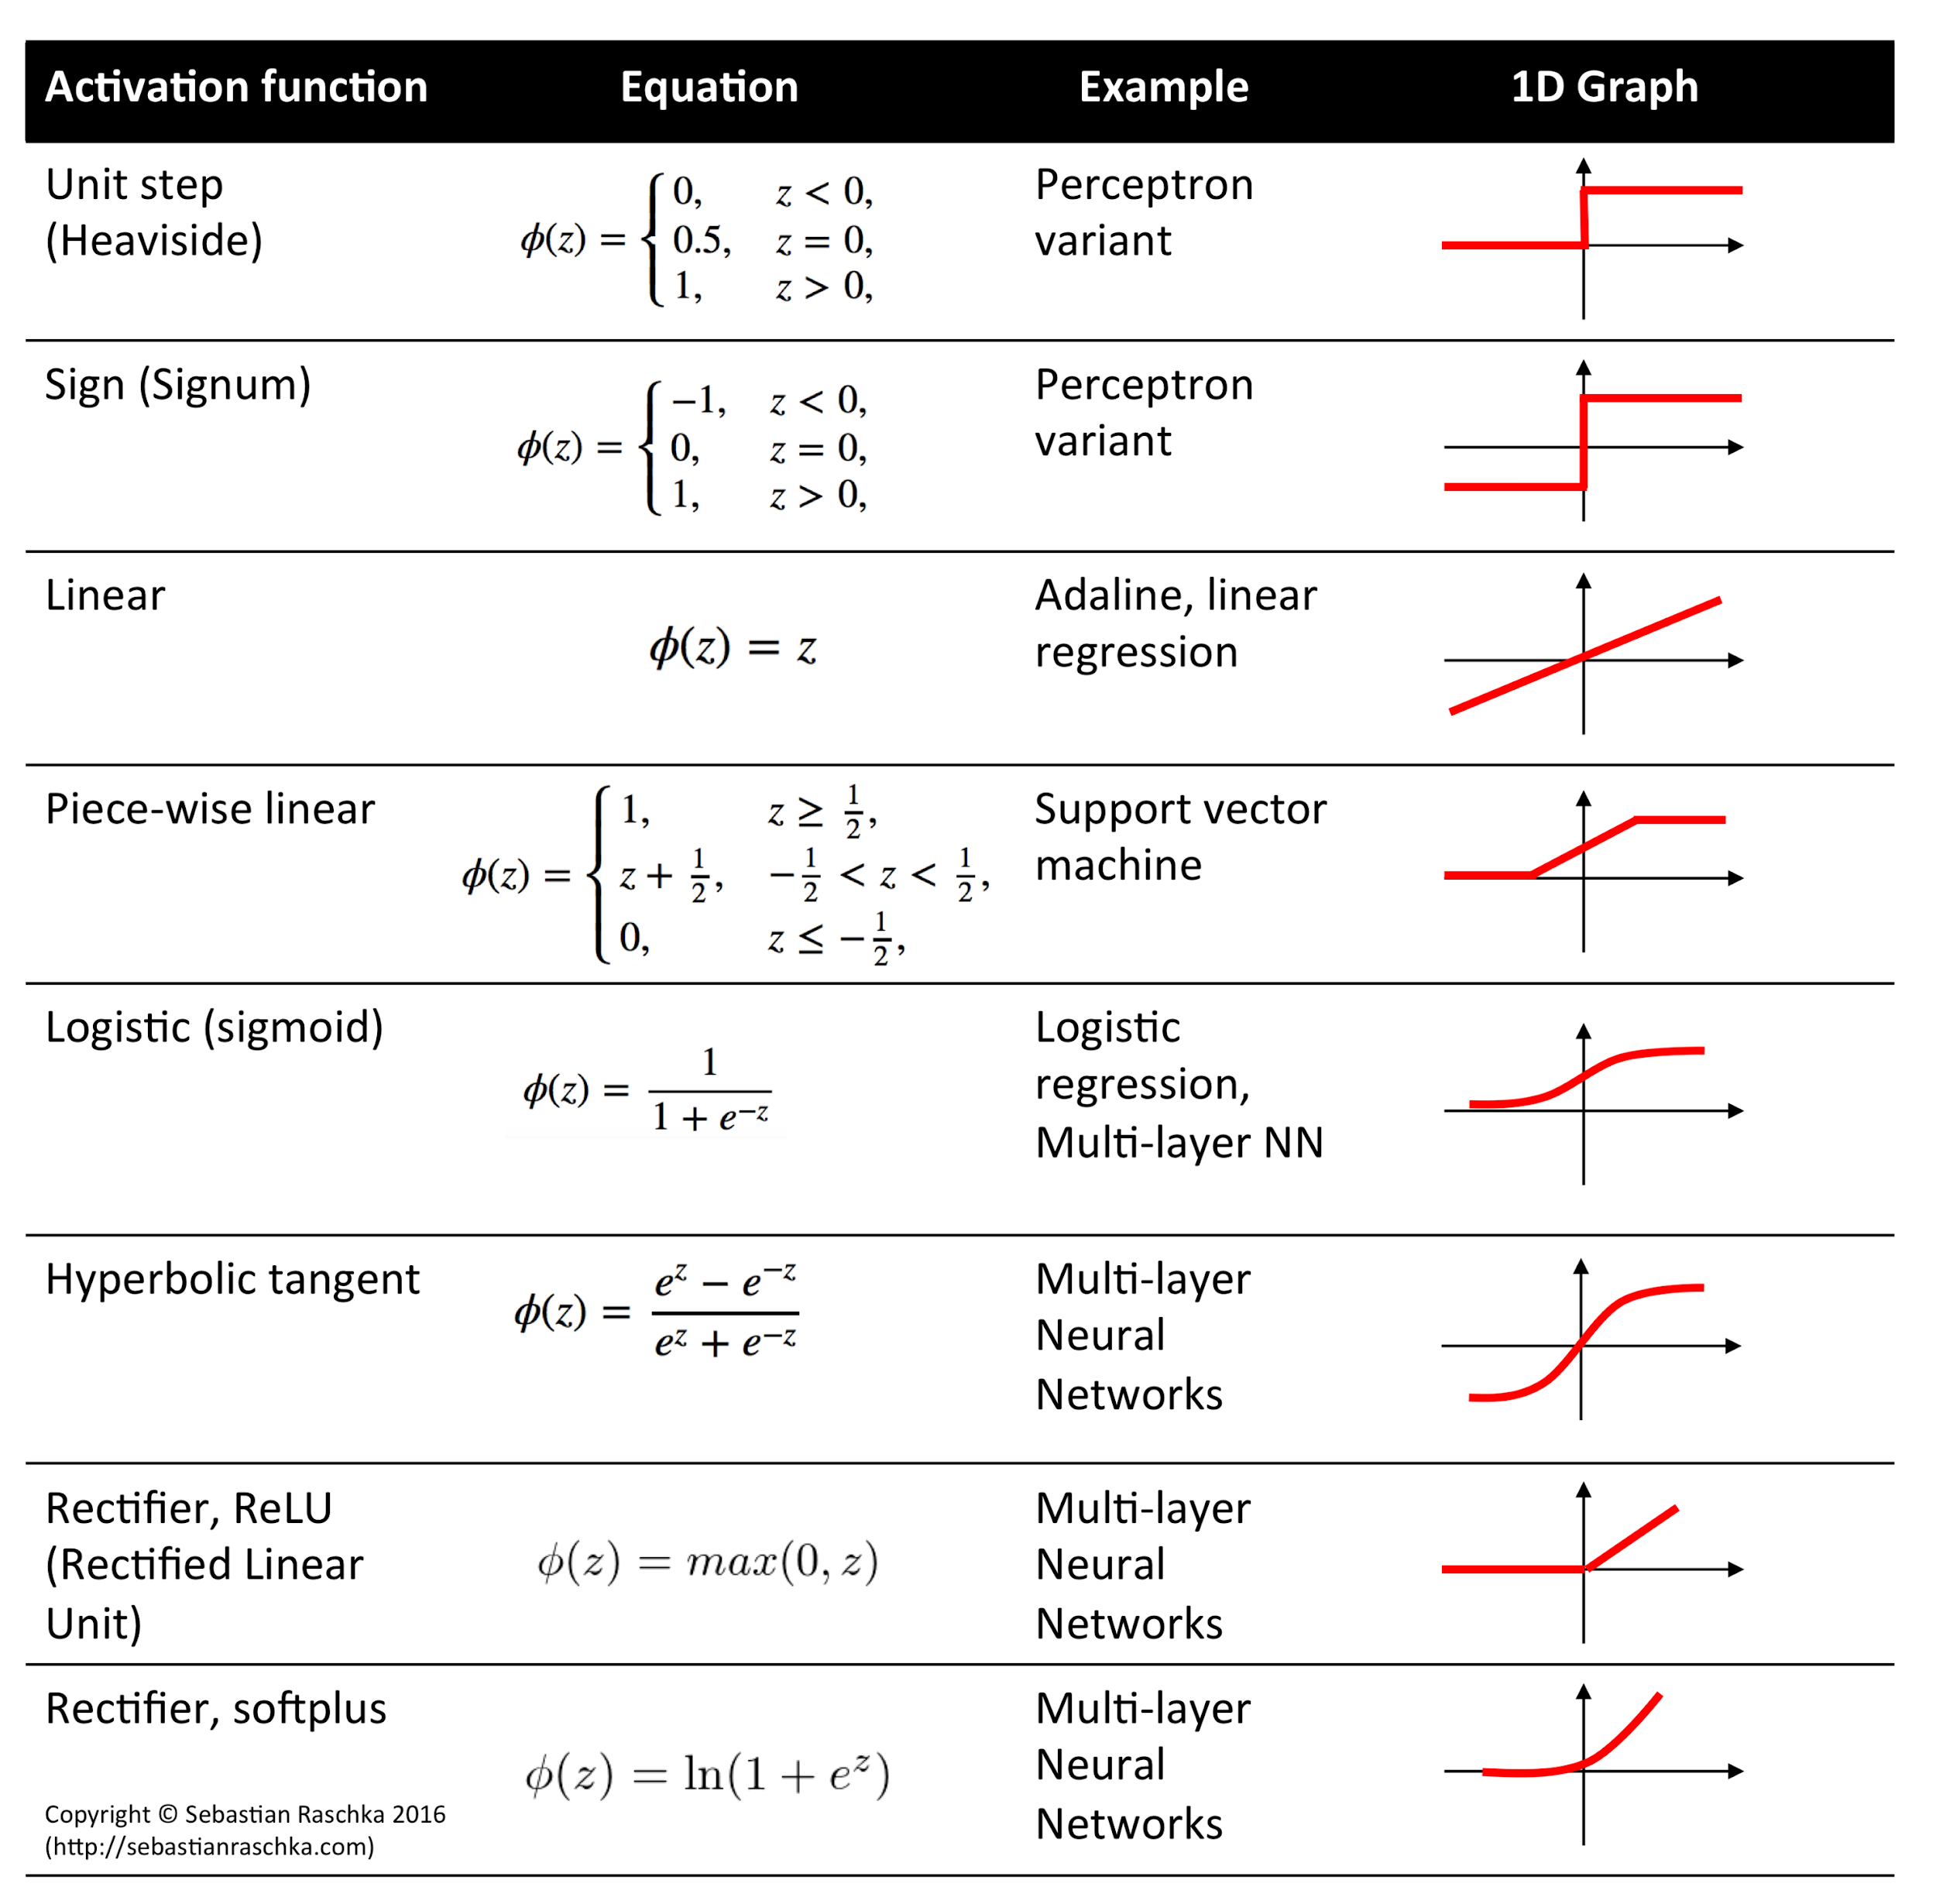
Activation Functions
Linear
Activation
http://rasbt.github.io/mlxtend/user_guide/general_concepts/activation-functions/

Slide 25
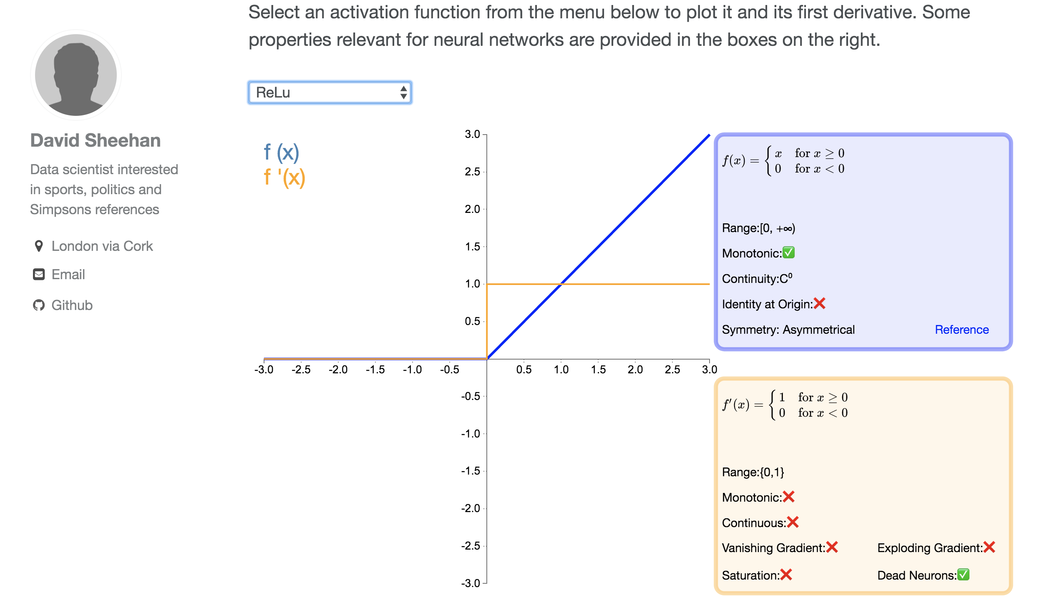
Many Activation Functions
https://dashee87.github.io/data%20science/deep%20learning/visualising-activation-functions-in-neural-networks/

Slide 26



Logistic regression
x_data = Variable(torch.Tensor([[1.0], [2.0], [3.0], [4.0]]))
y_data = Variable(torch.Tensor([[0.], [0.], [1.], [1.]]))
class Model(torch.nn.Module):
def __init__(self):
super(Model, self).__init__()
self.linear = torch.nn.Linear(1, 1) # One in and one out
def forward(self, x):
y_pred = F.sigmoid(self.linear(x))
return y_pred
# our model
model = Model()
criterion = torch.nn.BCELoss(size_average=True)
optimizer = torch.optim.SGD(model.parameters(), lr=0.01)
# Training loop
for epoch in range(1000):
# Forward pass: Compute predicted y by passing x to the model
y_pred = model(x_data)
# Compute and print loss
loss = criterion(y_pred, y_data)
print(epoch, loss.data[0])
# Zero gradients, perform a backward pass, and update the weights.
optimizer.zero_grad()
loss.backward()
optimizer.step()
# After training
hour_var = Variable(torch.Tensor([[1.0]]))
print("predict 1 hour ", 1.0, model(hour_var).data[0][0] > 0.5)
hour_var = Variable(torch.Tensor([[7.0]]))
print("predict 7 hours", 7.0, model(hour_var).data[0][0] > 0.5)
Design your model using class
Linear
Sigmoid
Construct loss and optimizer (select from PyTorch API)
Training cycle
(forward, backward, update)
Notes:
\hat{y}=x*w+b
loss = \frac{1}{N}\sum_{n=1}^{N} y^{(n)} \log \hat{y}^{(n)} + (1 - y^{(n)}) \log (1-\hat{y}^{(n})

Slide 27
手寫辨識系統MNIST

Slide 28
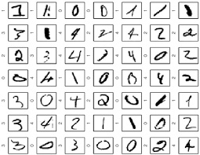
MNIST: 10 labels

Slide 29

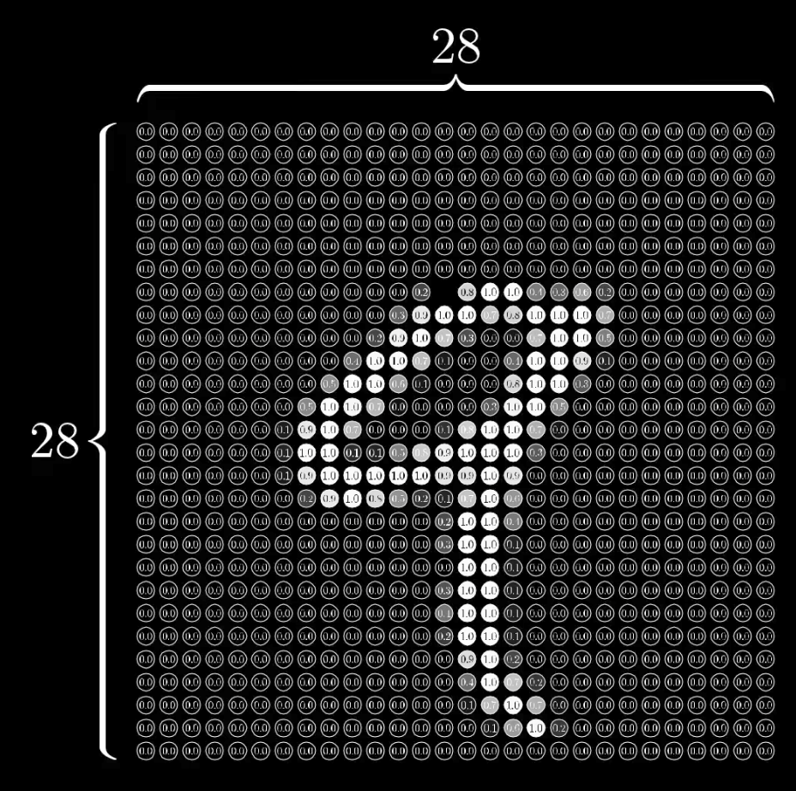
MNIST input
28x28 pixels = 784

Slide 30
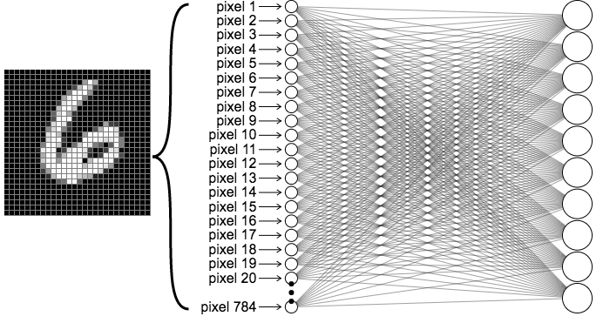

MNIST Network
output layer
10 (labels)
Input layer 784

Slide 31
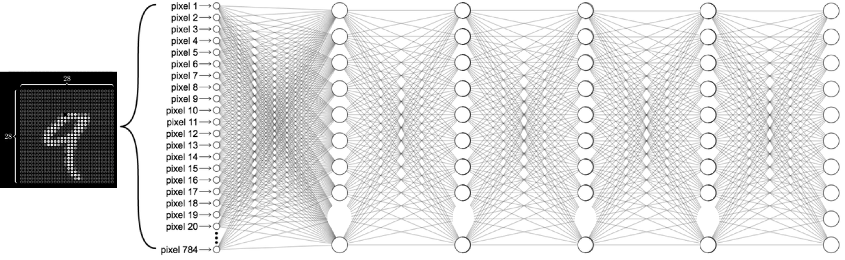
MNIST Network
Input layer 784
Hidden layers
output layer
10 (labels)

Slide 32
MNIST Network
Input layer 784
hidden 1: 520
hidden 2: 320
hidden 3: 240
hidden 4: 120
output layer
10 (labels)

Slide 33
MNIST Network

